Slide 1
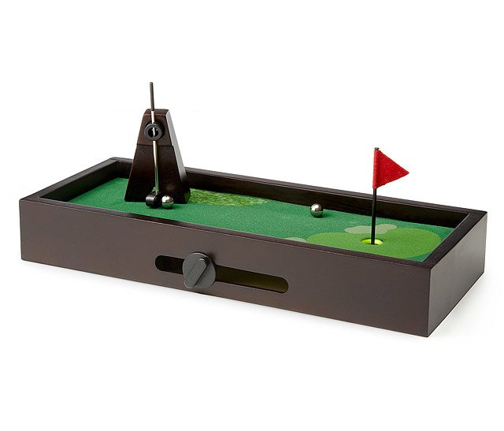
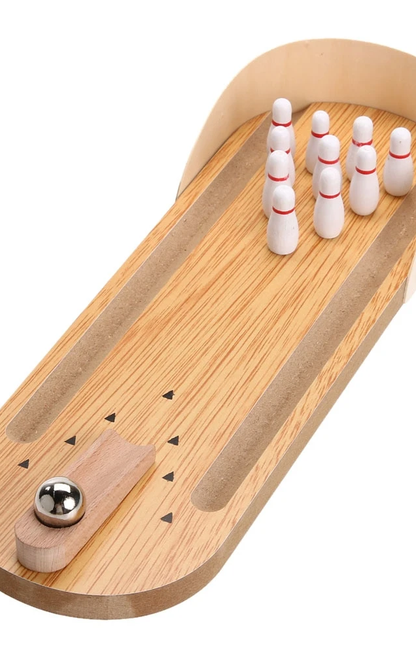
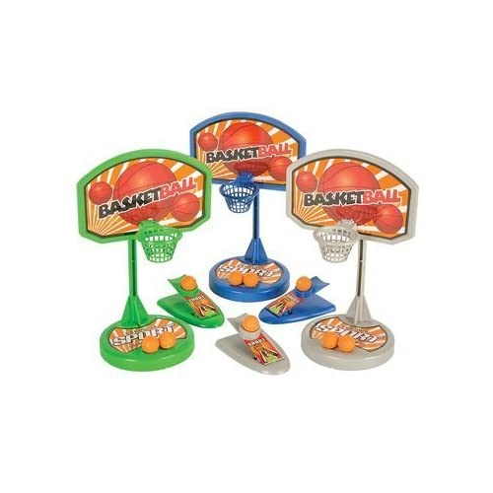
Task 1- Desktop Games Design
Desktop games have been around for several years as fun gifts or to give yourself something to do in breaks from work . Due to advances on electronics and manufacturing technology, there is an opportunity to reinvent the traditional desktop game using more advanced technology.
Your task is to design a modern version of a desktop game that is more advanced than those available now. It will be marketed at successful businesspeople with a significant disposable income so don’t worry about using expensive parts of technologies.
You might consider using:
Remote control players or vehicles
Automatic scoring
Sounds or commentary
Use of miniature cameras or virtual reality within the game
BE CREATIVE- YOU CAN BASE THE GAME ON ANY EXISTING SPORT/GAME OF CREATE ONE OF YOUR OWN!

Slide 2
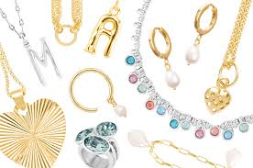
Task 2- Watch/Jewellery Design Task
For this task I would like you to revisit the short task many of you completed before half term where you used scruffiti to design a new accessory; watch, belt buckle, sunglasses, jewellery items, wallet/purse etc.
When you did it in the lesson we did it quite quickly (15 mins) so this time you have a whole hour to put more quality/detail into the design drawings.
You should come up with at least three different designs. Its up to you whether you do three different versions of the same product, or three different products altogether.
You can see two examples here of how scruffiti has been used to generate two different watch designs- remember you can use your scruffiti shape a number of times, as you can see on the pink and blue design.

