Slide 1
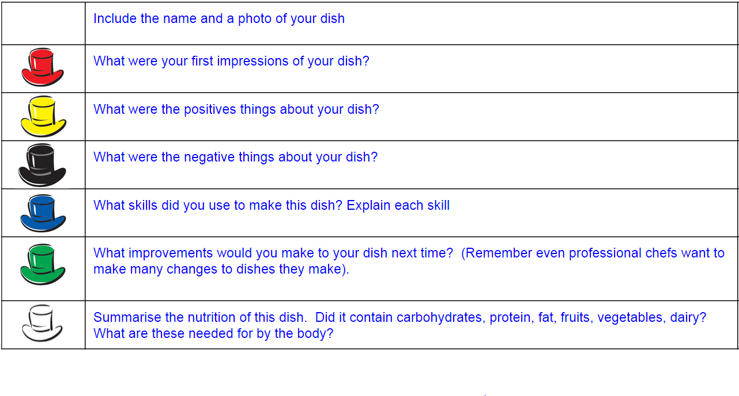
Year 7 Home Study Workbook
Checklist:
GOOD: Each week try to cook at least one dish at home for your family using the recipe sheets and complete a dish review using the debono hats
GREAT: Complete the theory question slides
AMAZING: Complete the extension tasks
Use the debono hats for your practical evaluations. Use at least 4 hats and colour code so your teacher knows which hat you are using to evaluate

Slide 2
Spaghetti Bolognese - try at home recipe
You will need:
Garlic x 1
Onion x 1
Carrot x 1
Celery x 1
Mince meat x 1 pack
Chopped tomatoes x 1 tin
Spaghetti x 1 pack

Slide 3
Spaghetti Bolognese Evaluation
If you can - Insert a picture of your dish here!
Go to insert, image, camera
Take a pic using your laptop or phone!
Remember to use at least 4 of the Debono hats!

Slide 4
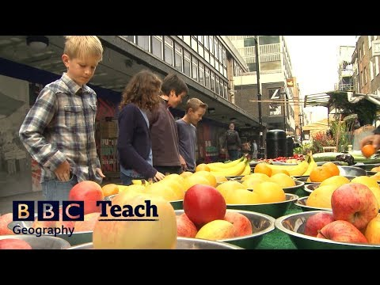
Food Provenance and Food Miles
What does this mean!?
This means where in the world your food has come from and if it was grown, reared or caught.
Animals grown on a farm

Slide 5
Week 1:Spaghetti Bolognese Questions
Task: Read your recipe sheet:
1. Which skills will you carry out...
2.What nutrients are in the dish?
3. Explain the term “food provenance”
4. Explain where your ingredients have come from in your dish today (Challenge can you work out the food miles?)

Slide 6
Sizzling Stir Fry - try at home recipe
You will need:
Noodles (1 nest per person)
Chicken breast (1 feeds 2 people)
Garlic x 1
Chilli x 1
Ginger (thumb sized piece)
Onion x 1
Mushrooms (handful)
Bell pepper x 1
Cabbage (handful chopped)
Pack choi x 1
Soy sauce

Slide 7
Sizzling Stir Fry Evaluation
Insert a picture of your dish here!
Go to insert, image, camera
Take a pic using your laptop or your phone!
Remember to use at least 4 of the Debono hats!

Slide 8
Sizzling Stir Fry Theory

Slide 9
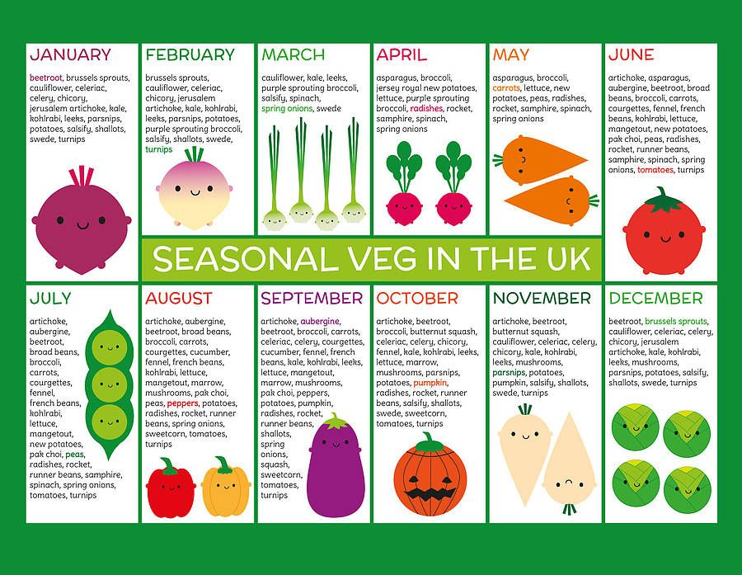

Slide 10
Sizzling stir Fry Questions
Task: Use the seasonality chart
1. Explain what seasonality means
2.What vegetables did you use in your stir fry?
3. Use the seasonality table on slide 10 - What months are your vegetables in season?
Challenge - What vegetables could you use to make a stir fry in winter? What vegetables could you use o make a stir fry in summer?

Slide 11
Sizzling Stir Fry - Extension Task
Complete a poster showing the different fruits and vegetables in season throughout the year in the UK:

Slide 12
Sweet Treat Week - Millies Cookies

Slide 13
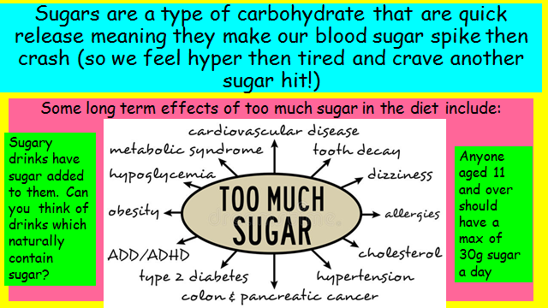
Sweet Treat Week - Millies Cookies

Slide 14
Sweet Treat Week - Millies Cookies

Slide 15
Sweet Treat Week - Millies Cookies
TIme to get thinking: Select 4 items of food out of your cupboards that have food labels (you could pick cereals, snacks or tins of food) - arrange them from most sugar to least sugar.
Reflect: Were you surprised by the amount of sugar in each product? How much of each product can you eat per day?
Product | Amount of sugar in 100g of the product | Rank (most to least sugar)

Slide 16
Sweet Treat Week - Millies Cookies
1. What is the maximum amount of sugar you should consume a day?
2.What are some of the long term effects of too much sugar?
3. What are some of the short term effects of too much sugar?
4. Explain why sugary and fatty foods are on the outside of the eatwell guide.
Challenge - How could we make the millies cookies recipe healthier? (think about the quantities of butter and sugar)

Slide 17
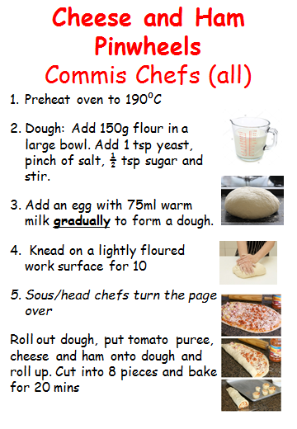
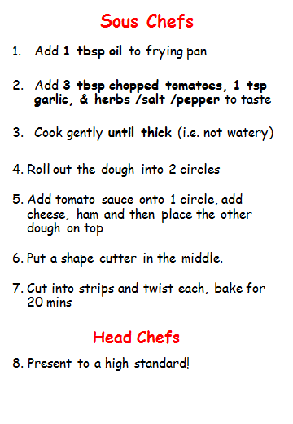
Pizza - Try at home recipe
Try the easy commis chef version, the harder sous chef version or the hardest head chef version

Slide 18
Pizza Evaluation
Insert a picture of your dish here!
Go to insert, image, camera
Take a pic using your laptop!
Remember to use at least 4 of the Debono hats!
I am a ……. Chef today!

Slide 19
Becoming a Chef!
Plan a dish of your own choice and make this at home!

Slide 20
Your dish should be based on:
Using the Eatwell Guide design a healthy lunchtime dish to be sold in the school canteen.
Task:
On the next page mind map some ideas of dishes you would like to make.
Remember the recipe will need to be adjusted to be for 1 person

Slide 21
Challenge Brief Theory:
MIND MAP!
Use bbcgoodfood to help you find recipes

Slide 22
Challenge Brief Theory:
Narrow your choices down to 3:
1.
2.
3.
2. Justify which can include seasonal vegetables:
3. Look on the practical skills on slide 1 to see which one is the most suitable for you to try a range of skills in the dish according to your target:
4. Then pick the most suitable dish to make:

Slide 23
Assessment Dish Summary
Name of your dish
What recipe will you be using? If this is off the internet insert the web address:
Describe which parts of the Eatwell plate your dish will include
Explain how your dish fits into the Eatwell Guide and includes seasonal ingredients
Identify and explain what skills you will be carrying out when making this dish

Slide 24
Complete the below tables including all that you will be using in your meal
Ingredient list | Equipment list | Skills list

Slide 25
Complete the table below. Including step by step how you will make your meal, including timings and health & safety points you may need to consider when making the dish
Timings | Method | Healthy & Safety Points

Slide 26
Timings | Method | Healthy & Safety Points

Slide 27
Timings | Method | Healthy & Safety Points

Slide 28
How are you going to present your dish?
Research different presentation ideas and copy them on this page.
How are you going to present your dish? Pick an idea and explain why you have chosen this.

Slide 29
Dish Evaluation
Evaluate your dish explaining how well it met the brief and use the debono hats Remember to use full sentences and the correct grammar, you may go onto the next slide if you need to.
Insert a picture of your final dish here
Insert a picture of a WAGOLL of your dish

Slide 30
Dish Evaluation Continued

